Slide 1
Shellcoding
Notes:
In this chapter we turn our attention specifically to buffer overflow attacks. This
type of attack is one of the most common attacks seen and results from careless
programming in applications. A look at the list of vulnerability advisories from
organizations such as CERT or SANS continue to include a significant number of
buffer overflow or heap overflow exploits, including a number of serious, remotely
exploitable vulnerabilities. Similarly, several of the items in the CWE/SANS Top 25
Most Dangerous Software Errors list, Risky Resource Management category, are
buffer overflow variants. These can result in exploits to both operating systems and
common applications, and still comprise the majority of exploits in widely deployed
exploit toolkits [VEEN12]. Yet this type of attack has been known since it was first
widely used by the Morris Internet Worm in 1988, and techniques for preventing
its occurrence are well known and documented.

Slide 2
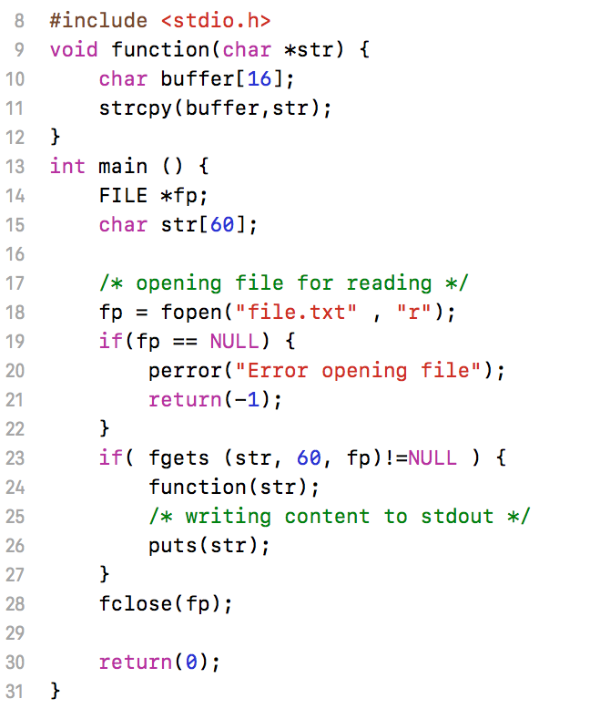
Basic Stack Smashing

Slide 3
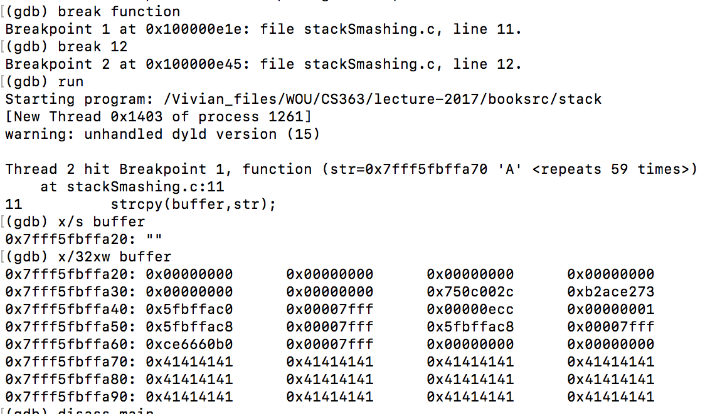
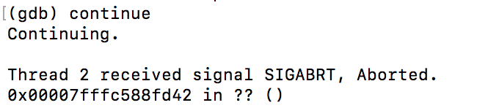
buffer
return addr

Slide 4
What is Shellcode
A set of instructions that are injected by the user and executed by the exploited binary
Generally the ‘payload’ of an exploit
Using shellcode you can essentially make a program execute code that never existed in the original binary
You’re basically injecting code
Historically started a command shell

Slide 5
Back Ground Information
EAX, EBX, ECX, and EDX are all 32-bit General Purpose Registers on the x86 platform.
AH, BH, CH and DH access the upper 16-bits of the GPRs.
AL, BL, CL, and DL access the lower 8-bits of the GPRs.
ESI and EDI are used when making Linux syscalls.
Syscalls with 6 arguments or less are passed via the GPRs.
XOR EAX, EAX is a great way to zero out a register (while staying away from the nefarious NULL byte!)

Slide 6
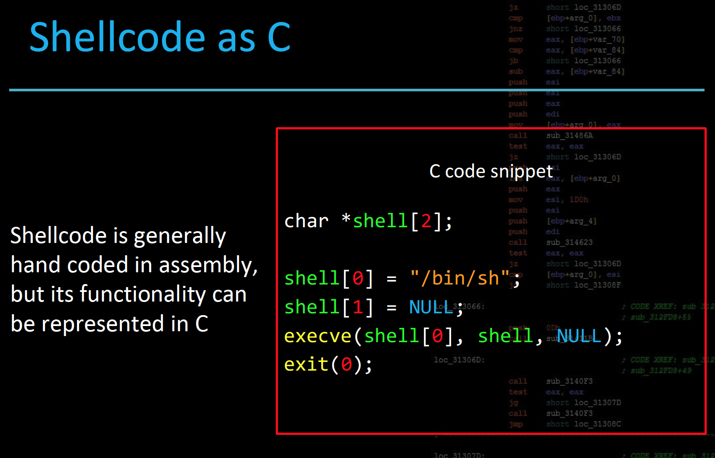

Slide 7
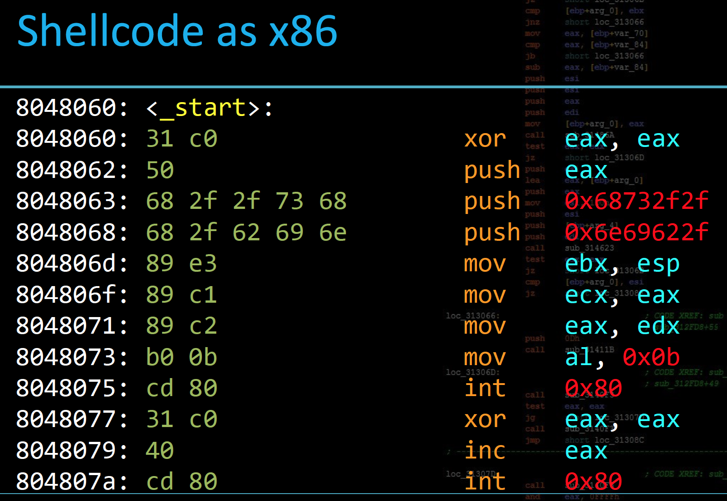

Slide 8
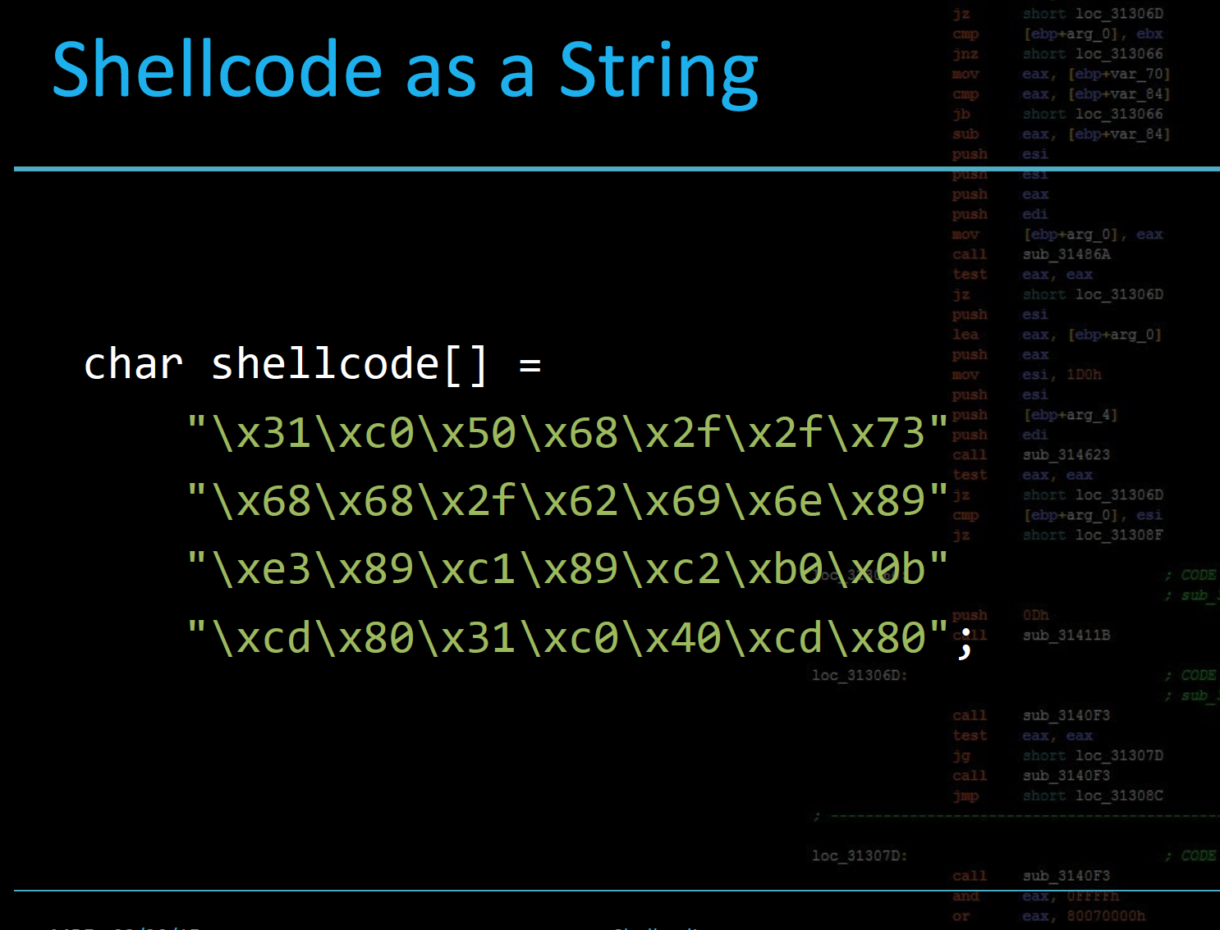

Slide 9
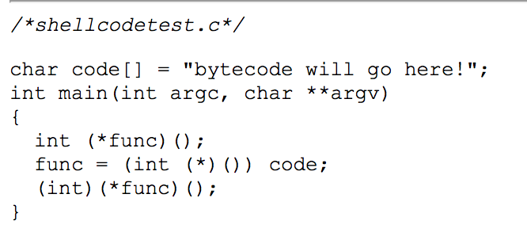
Test Shellcode in a Program

Slide 10
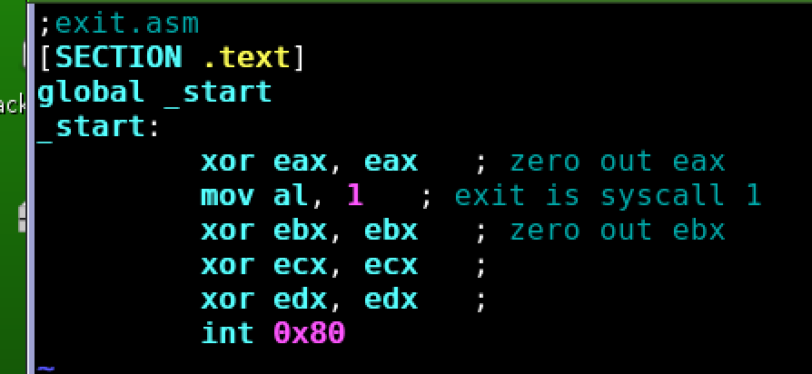
Example : Exit

Slide 11
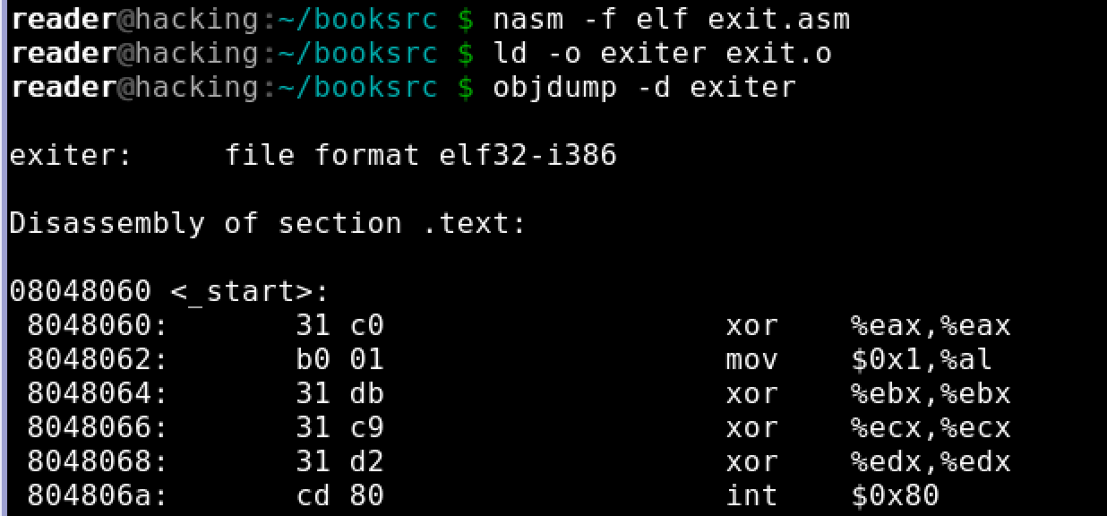

Slide 12
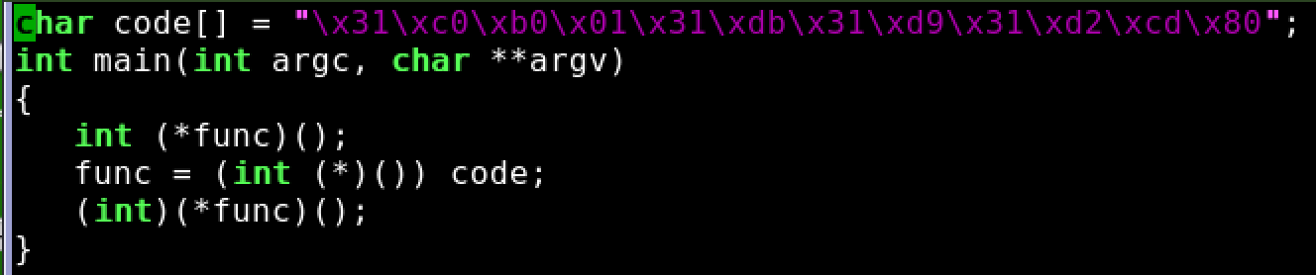

Slide 13
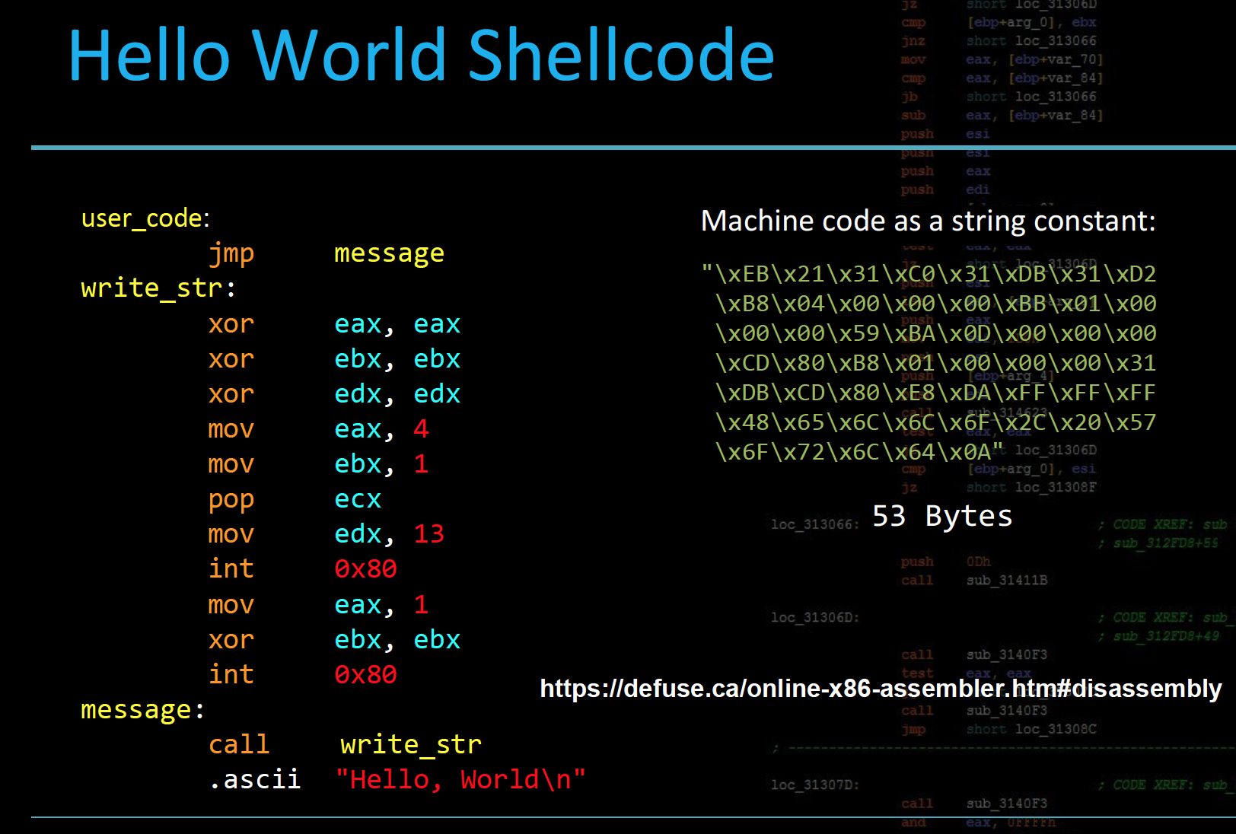

Slide 14
0 or Null
When shellcode is read as a string, null bytes become an issue with common string functions.
Solution: Make your shellcode NULL free!
The instruction
mov eax, 4 ; “\xB8\x04\x00\x00\x00”
can be replaced by:
mov al, 4 ; “\xb0\x04”

Slide 15
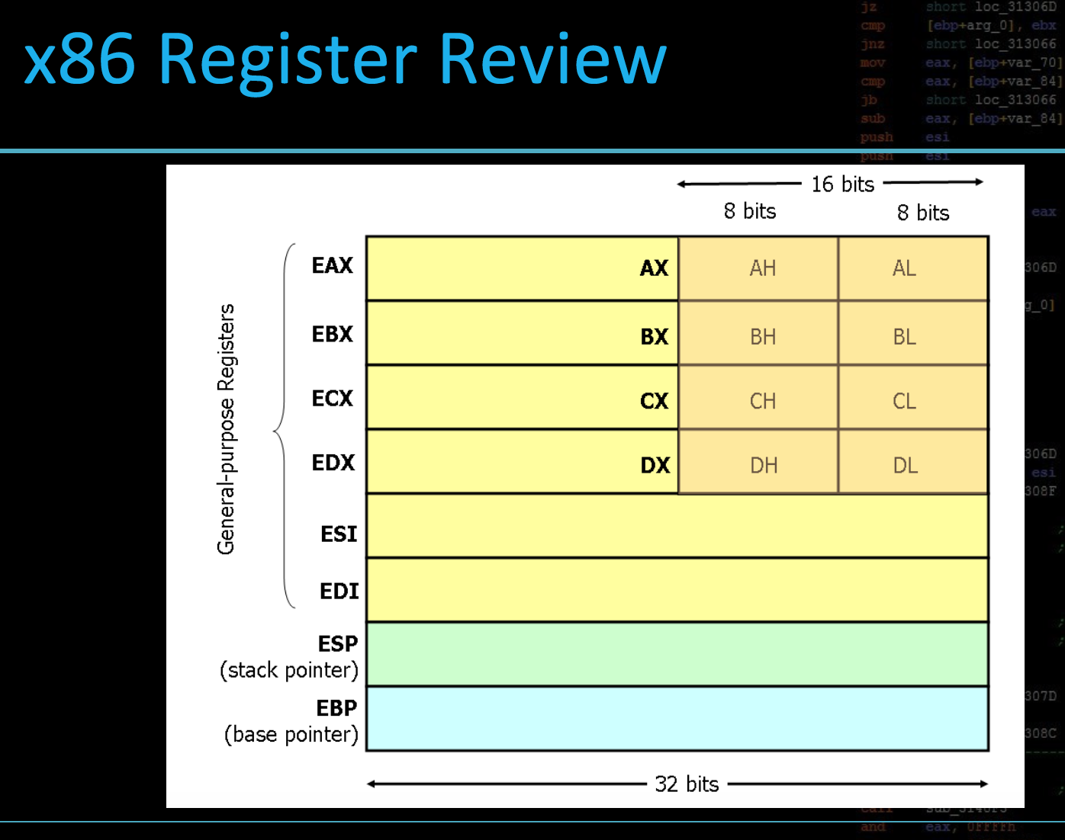

Slide 16
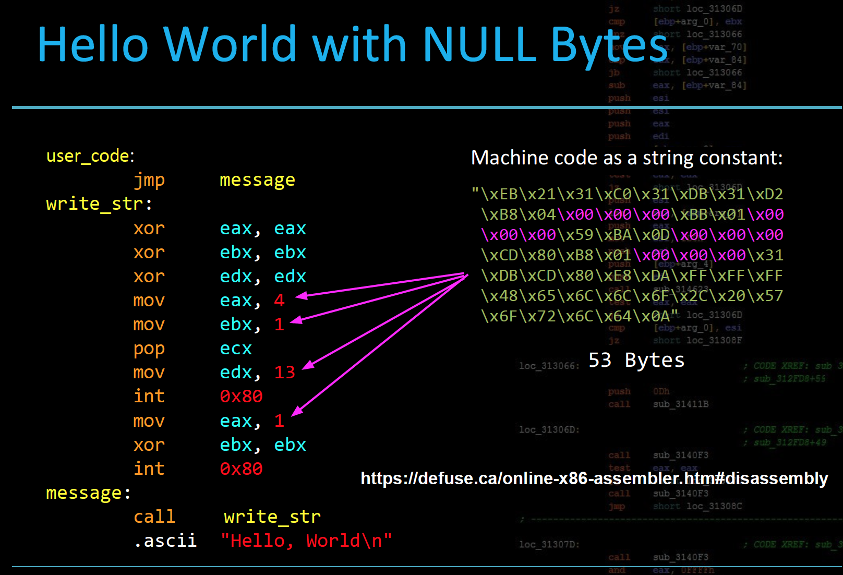

Slide 17
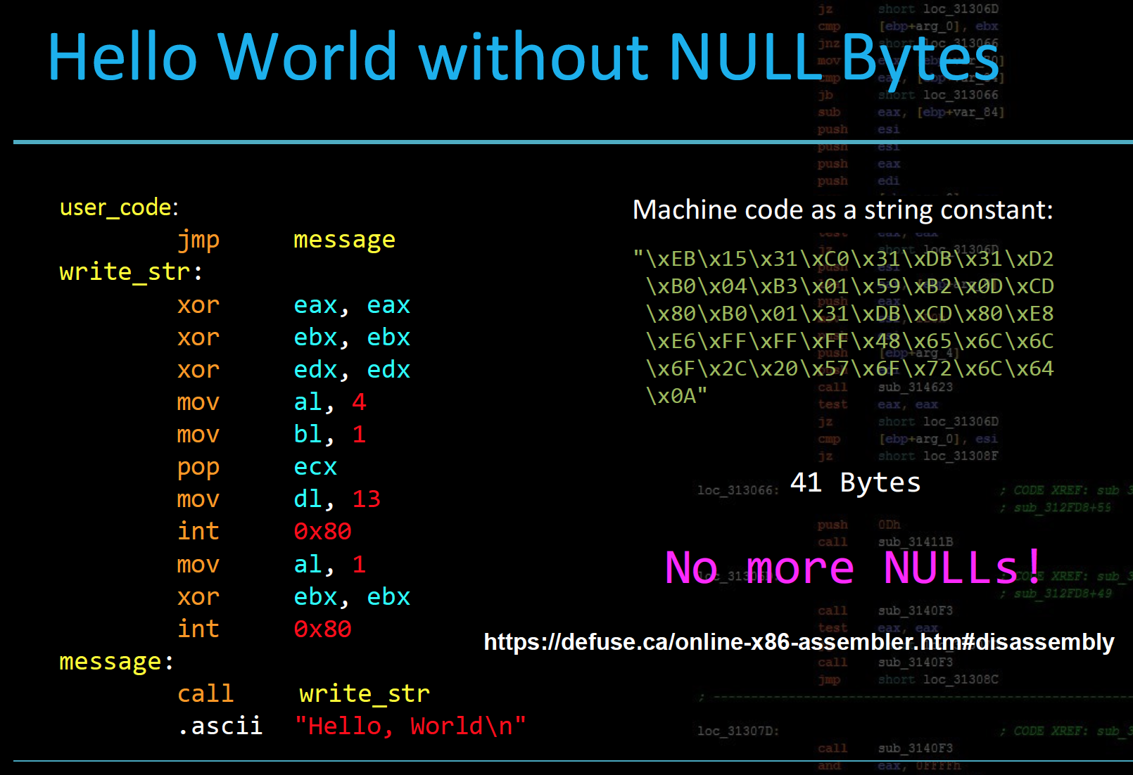

Slide 18
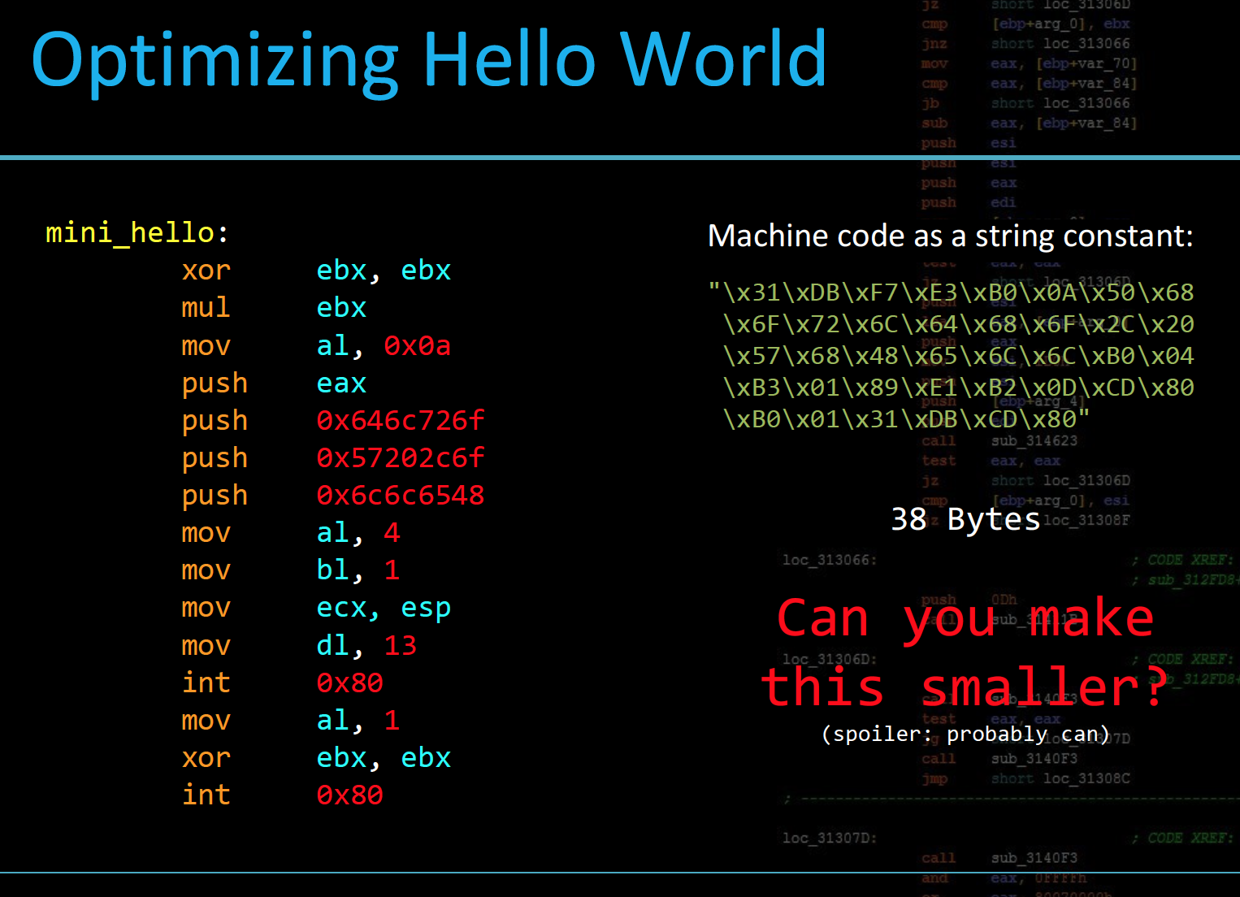

Slide 19
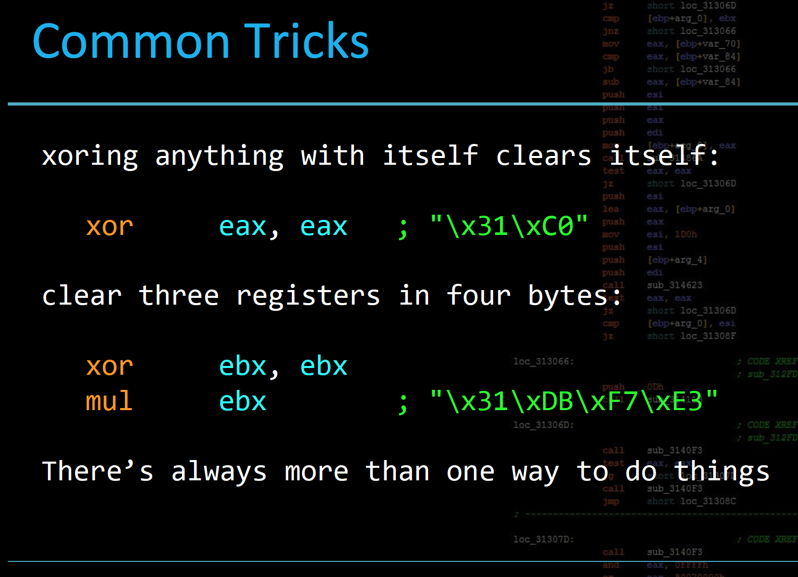

Slide 20
Linux System Calls
System calls are how userland programs talk to the kernel to do anything interesting
open files, read, write, map memory, execute programs, etc
libc functions are high level syscall wrappers
fopen(), sscanf(), execv(), printf() ...

Slide 21
Using Syscalls in Shellcode
Like programs, your shellcode needs syscalls to do anything of interest
Syscalls can be made in x86 using interrupt 0x80
int 0x80

Slide 22
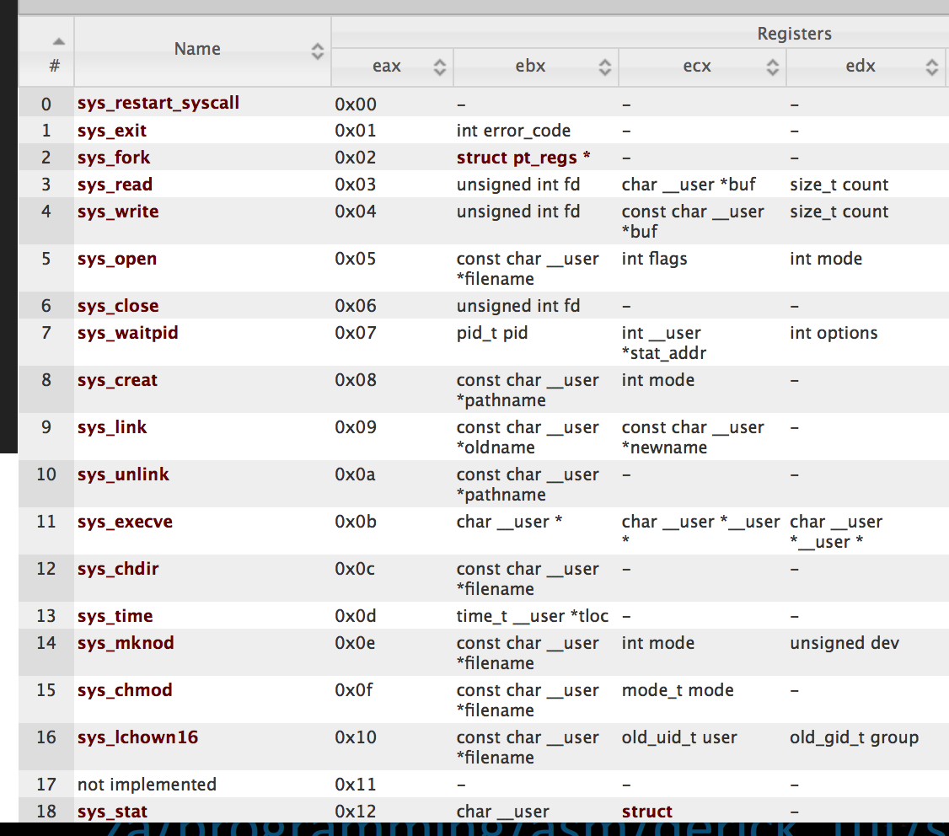
Linux Systemcall

Slide 23
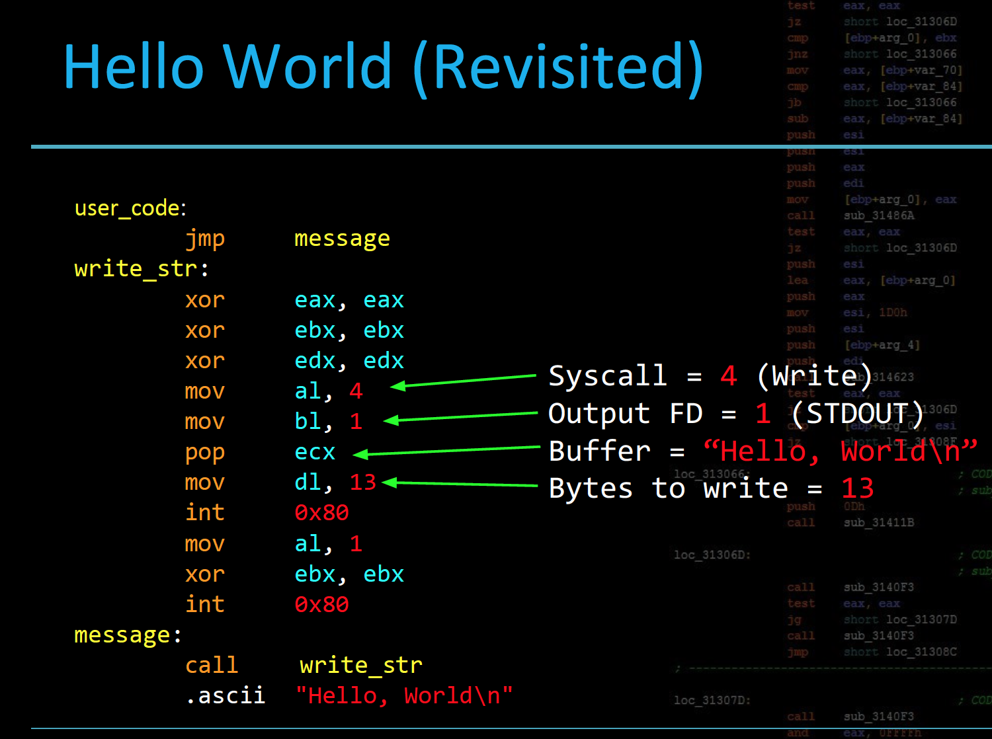

Slide 24
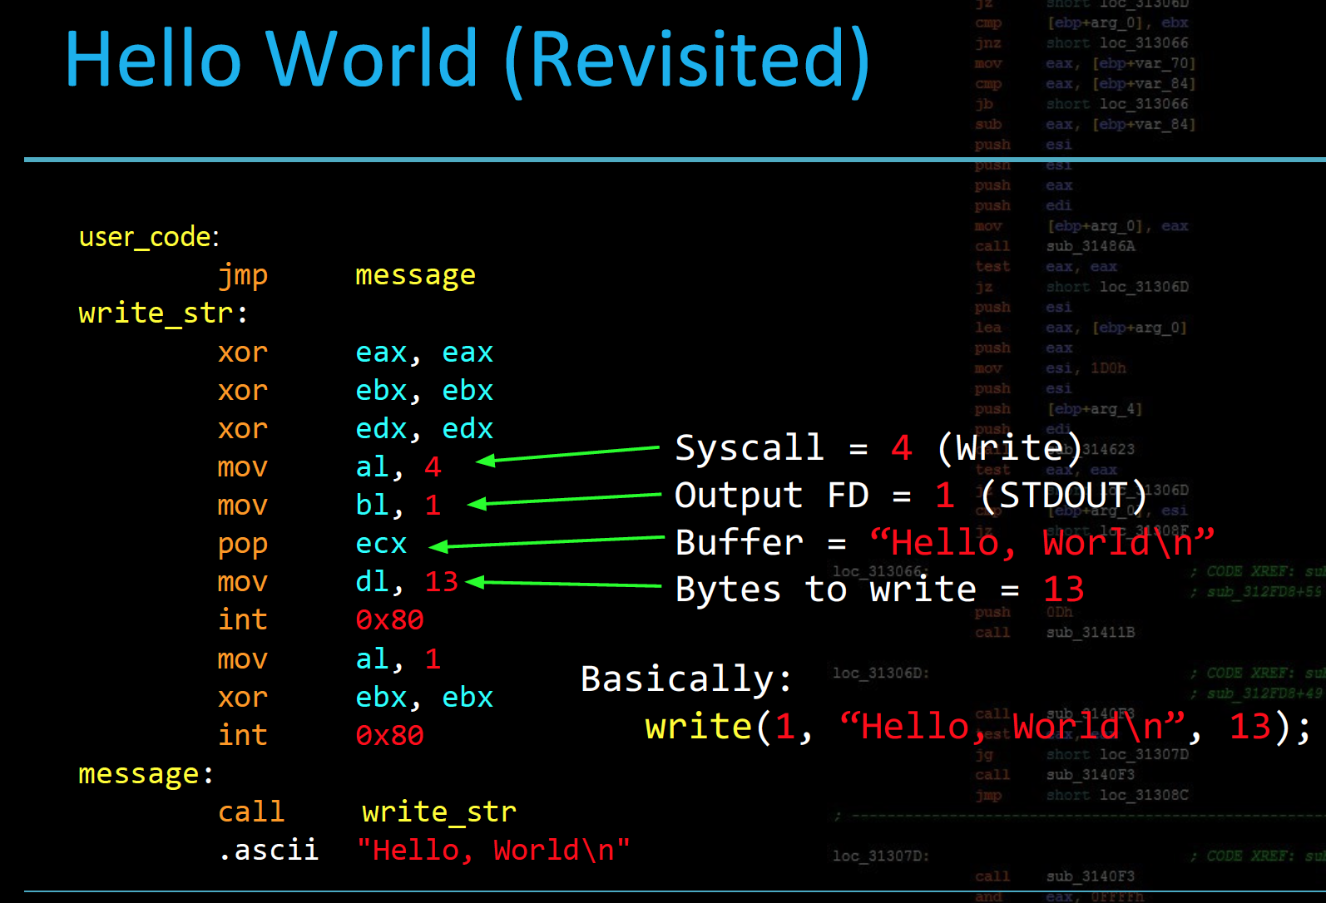

Slide 25
Syscall Summary
Linux Syscalls sorta use fastcall
- specific syscall # is loaded into eax
- arguments for call are placed in different registers
- int 0x80 executes call to syscall()
- CPU switches to kernel mode
- each syscall has a unique, static number

Slide 26
Example : Exit (Revisited)

Slide 28
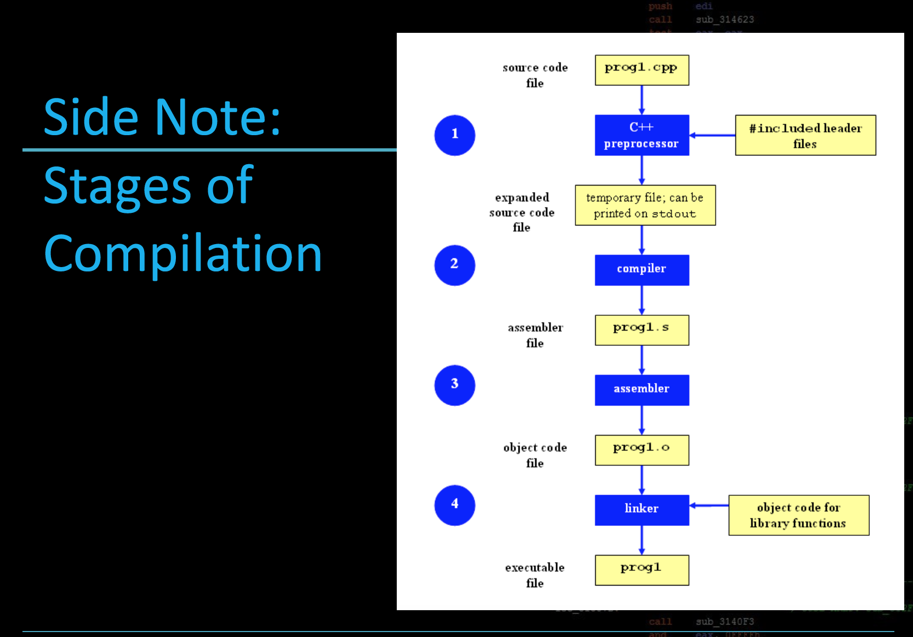

Slide 30
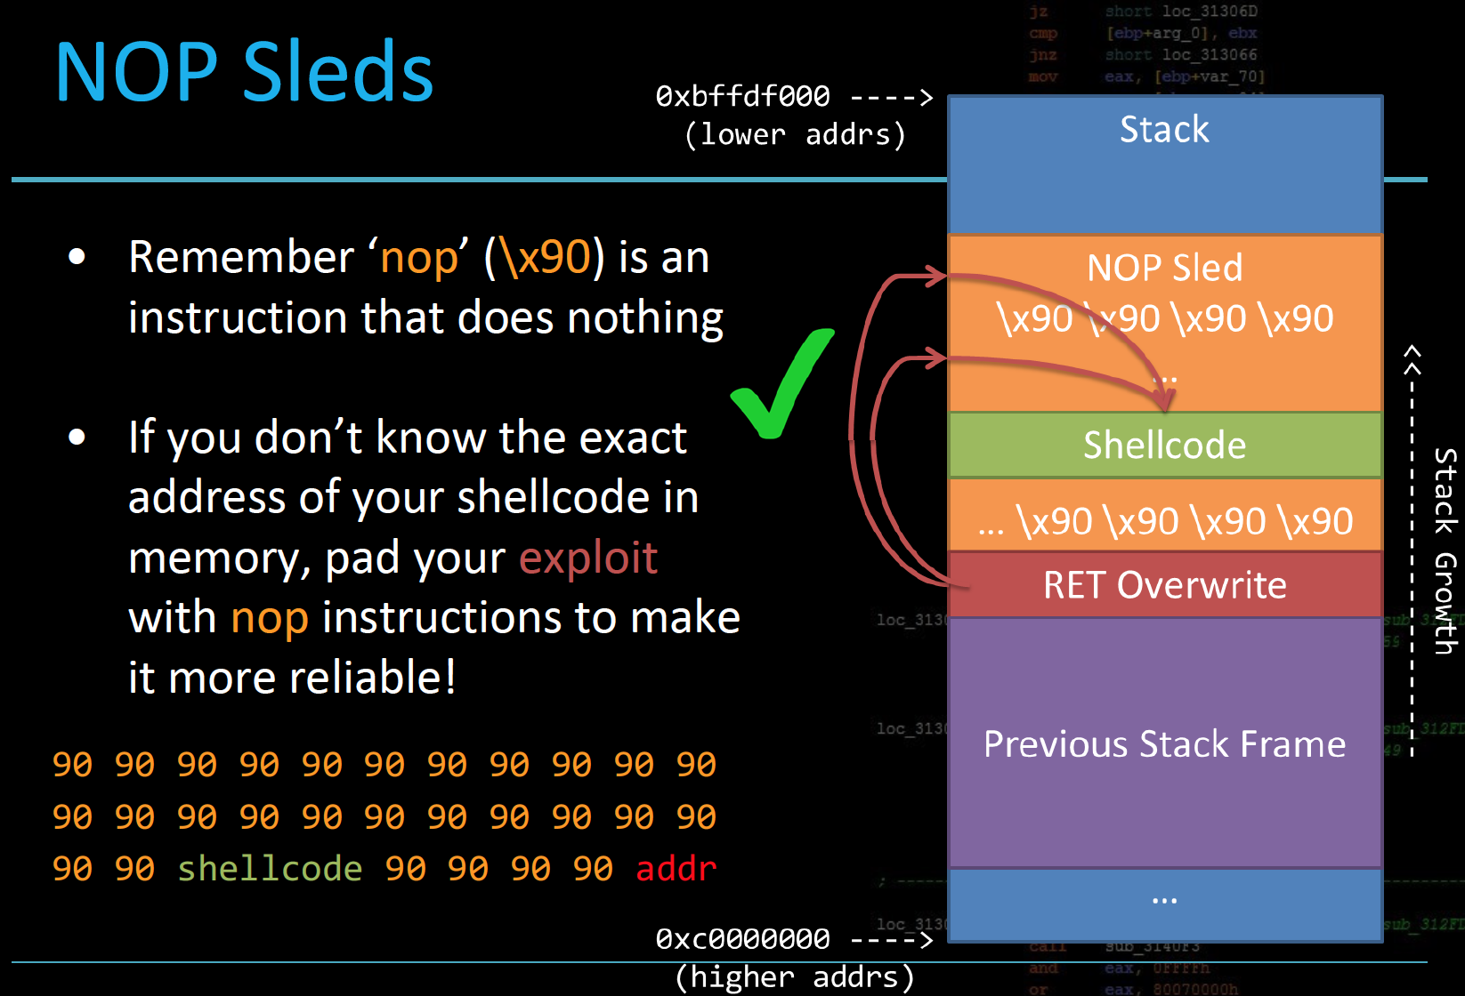
Exploit

Slide 31
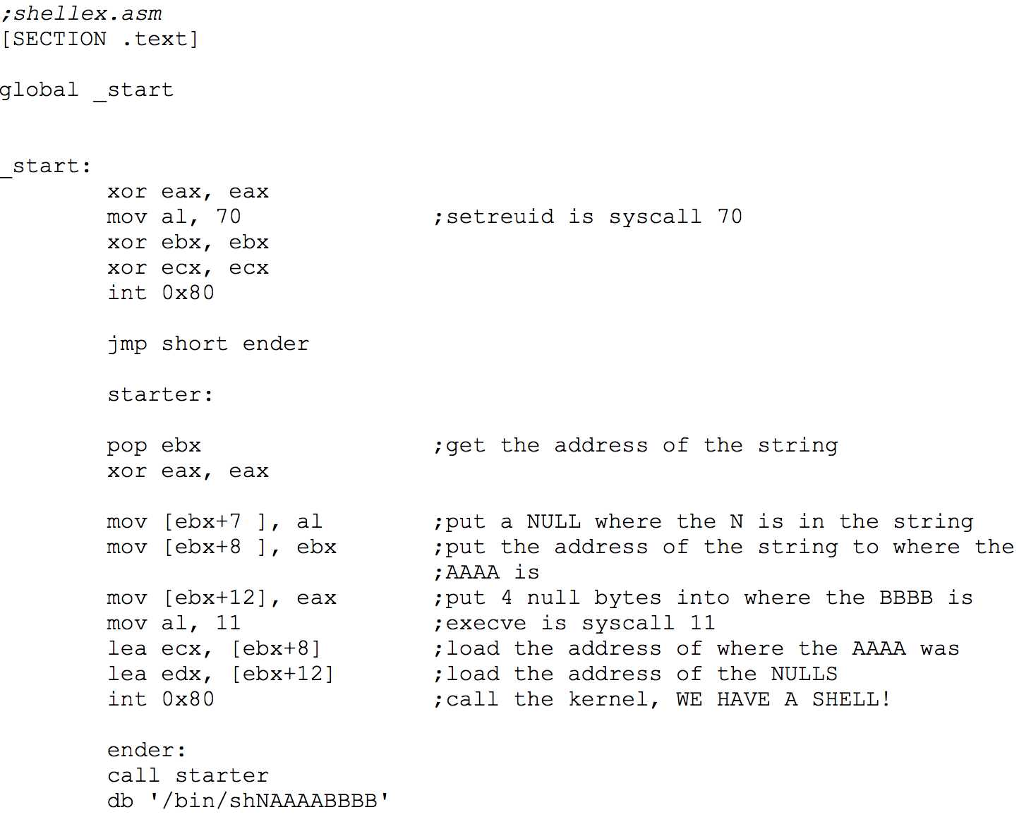
Spawn a Shell

